Slide 1


Slide 2
Completing the Operating Cycle

Slide 3
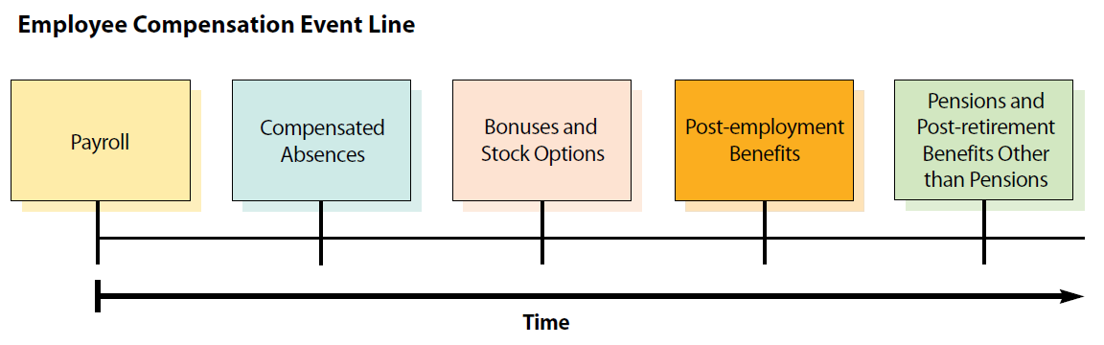
Employee Compensation
Employee Compensation
LO1

Slide 4
Payroll
LO1
Simple Form of Payroll Entries
Salaries Expense
XXX
Salaries Payable
XXX
Salaries Payable
XXX
Cash
XXX

Slide 5

Payroll
LO1
Gross Pay and Net Pay
Business is legally required to withhold certain taxes from employees’ salaries and wages.
For example, an employee who earns NT$44,000 per month probably takes home around NT$36,000.
Amount withheld by the employer
NT$44,000
NT$36,000
The gross pay
The net pay

Slide 6
Payroll—Income Tax
LO1
Employers normally withhold a portion of employee earnings for payment of the employees’ income tax.
Two Methods of Withholding Tax on Salary
According to Standards of Withholding Rates for Various Incomes, tax on salary can be withheld in two ways:
The total monthly payment is withheld in accordance with the Regulations Governing the Withholding of Tax on Wages.
The minimum salary required for this method is NT$73,501.

Slide 7
Payroll—Income Tax
LO1
Two Methods of Withholding Tax on Salary
5% of the total monthly payment is withheld.
Illustration
Suppose that Chi-yuen Chen’s salary is NT$44,000.
→ He can only use method (2)
NT$44,000 × 5% = NT$2,200

Slide 8
Payroll—Labor Insurance
LO1
Taiwan has a mandatory labor insurance program that includes labor insurance and employment insurance.
General Accident Benefits
Employees, employers, and the government prorate the payment for the general accident benefits.
Occupational Injury Payment
Employers in general are solely responsible for occupational injury payments.
Employment Insurance
Employees, employers, and the government prorate the payment for the employment insurance premium.

Slide 9
Payroll—Health Insurance
LO1
Participants in the National Health Insurance (NHI) program is mandatory for all companies and citizens in Taiwan.
The premium is split between the employer, the employee, and the government.
For the employees
For the employers
The employee’s insured salary
The insurance premium rate
The employee’s contribution ratio
The number of dependents
The employee’s insured salary
The insurance premium rate
The employer’s contribution ratio
The average number of dependents

Slide 10
Payroll—Labor and Health Insurance
LO1
Illustration
Labor Insurance
Health Insurance: Assume that Chi-yuen Chen has no dependent enrolled in the NHI program under his name.
Withheld by the employee
NT$836
Withheld by the employer
NT$2,970
Withheld by the employee
NT$648
Withheld by the employer
NT$2,204

Slide 11
Payroll—Pension
LO1
Employees receive cash compensation after they have retired.
Depending on the pension plan selected by the employees, an employer withholds a certain amount from its employees’ salary as the employees’ contribution to the pension fund.
The employer also contributes adequate amount to the employee’s pension account.

Slide 12
Payroll—Pension
LO1
Illustration
Suppose that Chi-yuen Chen agrees to contribute 10% of his salary to the pension fund.
His employer contributes 6% of his salary.
Withheld by the employee
NT$4,400 = NT$44,000 × 10%
Withheld by the employer
NT$2,640 = NT$44,000 × 6%

Slide 13
Payroll—Other Deductions
LO1
Employees may choose to have additional amounts deducted from their gross pay.
Retirement savings
Charitable contributions
Life insurance
Union dues

Slide 14
Payroll
LO1
Journal Entries
The accounting entry to record the expense for Chi-yuen Chen’s monthly salary is as follows:
Jan. 31
Salary Expense
44,000
Income Tax Withholding Payable
2,200
Labor Insurance Withholding Payable
836
Health Insurance Withholding Payable
648
Pension Contribution Withholding Payable
4,400
Salaries Payable
35,916
To record Chi-yuen Chen’s salary for January.
Do not represent an additional expense to the employer.

Slide 15
Payroll
LO1
Journal Entries
Companies must also pay insurance.
Jan. 31
Insurance Expense
5,174
Pension Expense
2,640
Labor Insurance Payable
2,970
Health Insurance Payable
2,204
Pension Liability Payable
2,640
To record Chi-yuen Chen’s January labor and health insurance contributed by employer.

Slide 16
Payroll
LO1
Journal Entries
Assume the company paid the salary on February 1, 2017, the withheld income tax on February 10, 2017, and the withheld insurance as well as pension contribution on February 28, 2017.
Feb. 1
Salaries Payable
35,916
Cash
35,916
Paid to Chi-yuen Chen’s January salary.
Feb. 10
Income Tax Withholding Payable
2,200
Cash
2,200
Paid January tax withholdings to government.

Slide 17
Payroll
LO1
Journal Entries
Feb. 28
Labor Insurance Withholding Payable
836
Health Insurance Withholding Payable
648
Pension Contribution Withholding Payable
4,400
Labor Insurance Payable
2,970
Health Insurance Payable
2,204
Pension Liability Payable
2,640
Cash
13,698
Paid January insurance withholdings and related expenses to the government.

Slide 18
Compensated Absences
LO1
When the compensation is in the form of wage, we need to account for additional benefits .
The matching principle requires that the expense associated with the compensated absence be accounted for in the period in which it is earned by the employee.

Slide 19
Compensated Absences
LO1
Sick Leave
If you earn both NT$100 a day and one sick leave per month, then you recognize an expense (and accrue a liability) of NT$100 per month related to your sick leave.
When you take a sick leave, the journal entry would be:
Salaries Expense
100
Sick Leaves Payable
100
To recognize accrued sick pay.
Sick Leaves Payable
100
Cash
100
To record payment of sick leave net of income taxes.

Slide 20
Compensated Absences
LO1
Sick Leave
Now suppose that you don’t take your sick leave until next year, and assume that you receive a NT$10 raise per day.
Sick Leaves Payable
100
Salaries Expense
10
Cash
110
To record payment of sick leave net of income tax.

Slide 21
Compensated Absences
LO1
Vacation Pay
The estimated vacation pay for the year ending December 31, 2016 is NT$200,000. The adjusting entry for the accrued vacation is shown below.
Dec. 31
Salaries Expense
200,000
Vacation Pay Payable
200,000
Record accrued vacation pay for the year.

Slide 22
Compensated Absences
LO1
Vacation Pay
Employees may be required to take all their vacation time within one year.
Or, employees may be allowed to accumulate their vacation pay.
Suppose one employee takes vacations on January 30, 2017 (valued NT$10,000)
→ Current liability
→ Non-current liability
Jan. 30
Vacation Pay Payable
10,000
Cash
10,000
Record payment of accrued vacation.

Slide 23
Bonuses
LO1
Many companies offer employee bonus plans that allow employees to receive additional compensation should certain objectives be achieved.
Individual awards are based on each employee’s job responsibility, contribution and performance.

Slide 24
Post-employment Benefits
LO1
Benefits paid to employees who have been laid off or terminated.
The amount of the post-employment cost should be estimated and accrued in the period in which the employee is actually terminated.
Salaries Expense
XXX
Benefits Payable
XXX
To record postemployment benefits for laid-off employees.

Slide 25
Pensions
LO1
A pension is cash compensation received by an employee after that employee has retired.
Defined Contribution Plan
Employer contributes a defined amount to the pension fund.
After retirement, employees receive the amount contributed plus whatever it has earned.
Defined Benefit Plan
Employer defines the amount that retiring employees will receive and contributes enough to the pension fund to pay that amount.

Slide 26
Pensions
LO1
Defined Contribution Plan
Assume that Chi-yuen Chen’s company contributes 6% of employee monthly salaries to his individual pension account. With the monthly salary of NT$44,000.
Jan. 31
Pension Expense
2,640
Cash
2,640
Contribute 6% of monthly salaries to an employee’s pension plan.

Slide 27
Pensions
LO1
Defined Benefit Plan
Assume that the defined benefit plan of COKA Co. requires an annual pension cost of NT$50,000. This annual contribution is based on estimates of COKA’s future pension liabilities.
On December 31, 2017, COKA Co. pays NT$10,000 to the pension fund.
Dec. 31
Pension Expense
50,000
Cash
10,000
Pension Liability Payable
40,000
Record pension cost and contribution.
Unfunded portion

Slide 28
Other Post-retirement Benefits
LO1
Employers often offer employees other benefits after their retirement.
E.g., ExxonMobil promises its employees that it will continue to cover them with health-care and life insurance plans after retirement.
Keep with the normal practice of matching expenses to the period in which they are initially incurred.

Slide 29
Sales Taxes (Business Taxes)
Taxes
LO2
Sales taxes are paid by customers to the seller, who in turn forwards them to the governmental agency.
Illustration
Assume that a sporting goods store in Denver prices a pair of skis at $200 and that the combination of state and city sales tax is 6.5%. When the store sells the skis, it collects $213.
Cash
213
Sales Revenue
200
Sales Tax Payable
13
Sold a pair of skis for $200. Collected $213, including 6.5% sales tax.

Slide 30
Value-Added and Non-Value-Added Business Tax
LO2
Business tax applies to the sales of goods and services in Taiwan.
Business tax consists of value-added tax (VAT) and non-value-added tax (non-VAT).
VAT is applicable to general industries, and the current rate is 5%.
Input Tax
Output Tax
Supplier
Seller
Customer
Purchase inventory
Sell inventory
→ The cost is passed on to the end consumer.

Slide 31
Value-added and Non-value-added Business Tax
LO2
Illustration—VAT
Assume that AMC Company acquires 10 notebooks for NT$200,000 from AUS Co. on March 20, 2017. AMC sells all notebooks to customers on March 30, 2017 for NT$220,000.
The business tax 5% is imposed on both transactions.
Mar. 20
Inventory
200,000
Input Tax
10,000
Cash
210,000
Pay for the inventory.

Slide 32
Value-added and Non-value-added Business Tax
LO2
Illustration—VAT
Mar. 20
Cash
231,000
Sales
220,000
Output Tax
11,000
Sell the inventory.
XXX
Output Tax
11,000
Input Tax
10,000
Business Tax Payable
1,000
Record accrued business tax payable.
XXX
Business Tax Payable
1,000
Cash
1,000
Pay for the VAT.

Slide 33
Property Taxes
LO2
Property taxes are usually assessed by county or city governments on land, buildings, and other company assets.
The company must report
A prepaid tax asset (if taxes are paid at the beginning of the tax year).
Or a property tax liability (if taxes are paid at the end of the tax year).

Slide 34
Property Taxes
LO2
Illustration
Assume that Yokum Company pays its property taxes of $3,600 on June 30, 2017, for the period July 1, 2017, to June 30, 2018. If Yokum is on a calendar-year basis and records the prepayment as an asset.
The adjusting entry at December 31, 2017:
Property Tax Expense
1,800
Prepaid Property Taxes
1,800
To record property tax expense for the property assessment period
July 1–December 31, 2017.

Slide 35
Property Taxes
LO2
Illustration
On June 30, 2018, property tax expense would be recognized for the period January 1, 2018, through June 30, 2018:
Property Tax Expense
1,800
Prepaid Property Taxes
1,800
To record property tax expense for the property assessment period
January 1–June 30, 2018.

Slide 36
Income Taxes
LO2
It is usually reported as the final expense.
Reported income tax expense may differ from the actual amount of cash paid for taxes for two reasons.
Income taxes are not necessarily paid in cash in the year in which they are incurred.
Income tax expense is based on reported financial accounting income, whereas the amount of cash paid for income taxes is dictated by the applicable government tax law.

Slide 37
Provisions
Provisions and Contingent Liabilities
LO3
According to IAS 37, provisions are liabilities of uncertain timing or amount. A provision should be recognized when and only when:
An entity has a present obligation as a result of a past event.
It is probable (i.e., more likely than not) that an outflow of resources embodying economic benefits will be required to settle the obligation.
A reliable estimate can be made of the amount of the obligation.

Slide 38
Provisions
LO3
Environmental Lawsuit Provision
A company is sued by the government for dumping toxic waste in manufacturing its products.
Warranty Liabilities
When companies sell a product, they usually provide warranty for repairs.
Companies should record the estimated product warranty expense and product warranty provision in order to match with the sales revenue.

Slide 39
Provisions
LO3
Illustration—Warranty Liabilities
Assume that Sun Co. sold electric appliances for NT$50,000 during July under a one-year warranty.
The average cost of repairs under the warranty is estimated at 4% of the sales price.
Jul. 31
Product Warranty Expense
2,000
Product Warranty Provision
2,000

Slide 40
Provisions
LO3
Illustration—Warranty Liabilities
On December 12, a customer required a NT$800 part replacement plus NT$50 of labor under the warranty.
Dec. 12
Product Warranty Provision
850
Supplies
800
Wages Payable
50

Slide 41
Contingent Liabilities
LO3
Contingent liabilities should not be recognized, but should be disclosed. A contingent liability is:
A possible obligation that arises from past events and whose existence will be confirmed only by the occurrence or non-occurrence of one or more uncertain future events not wholly within the control of the entity; or
A present obligation that arises from past events but is not recognized because:
(i) it is not probable that an outflow of resources embodying economic benefits will be required to settle the obligation; or
(ii) the amount of the obligation cannot be measured with sufficient reliability.

Slide 42
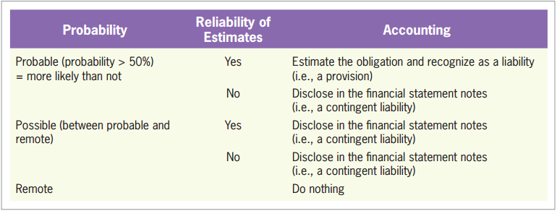
Accounting for Provisions and Contingent Liabilities
LO3
Exhibit 8.4

Slide 43
Quiz Yourself
LO3
Describe the appropriate accounting treatment in each of the following three scenarios involving provisions and contingent legal liabilities.
Adam Simpson Company has been sued by a group of disgruntled employees who have charged the company with discriminatory promotion practices. Adam’s legal experts believe that it is possible that the company will lose the lawsuit and be required to pay damages of about $200 million.
Disclosure. Because the likelihood of occurrence is possible, Adam will be required to describe the details of the possible liability in the notes to the financial statements.

Slide 44
Quiz Yourself
LO3
Bud Feller Bank violated federal banking regulations. Bud’s attorneys have concluded that it is probable that the bank will be required to pay a fine of about $50 million.
Recognition in the financial statements. Because the likelihood is probable, Bud will be required to debit a loss and credit a liability for $50 million. The details must also be described in a note.

Slide 45
Quiz Yourself
LO3
Iba Spikeway Company has been sued by a group of Renaissance troubadours who object to the company’s dress code, which bans the wearing of capes and feathered hats during work hours. The troubadours are seeking damages of $75 million. The chances that Iba will have to pay anything on this lawsuit are remote.
Nothing. Because the likelihood is remote, no accounting action is needed.

Slide 46
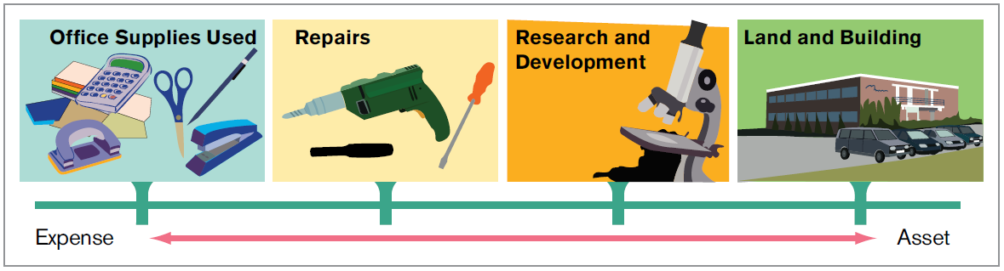
Capitalize versus Expense
Capitalize versus Expense
LO4
Sometimes it is difficult to determine whether an expenditure will benefit the future.
Exhibit 8.5
Should they be capitalized or be expensed?

Slide 47
Research and Development
LO4
Research
An activity undertaken to discover new knowledge that will be useful in developing new products, services, or processes.
Development
Involves the application of research findings to develop a plan or design for new or improved products and processes.

Slide 48
Research and Development
LO4
FASB
Because of the uncertainty surrounding the future economic benefit, the FASB decided that research and development expenditures should be expensed in the period incurred.
IASB
Research
Development
To be Expensed
To be Capitalized
When technological feasibility has been established.

Slide 49
Advertising
LO4
For accounting purposes, the general presumption is that advertising costs should be expensed because of the uncertainty of the future benefits.
However, in selected cases in which the future benefits are more certain, advertising costs should be capitalized.

Slide 50
Quiz Yourself
LO4
In which one of the following cases should the expenditure be recorded as an expense?
Advertising costs involving targeted advertising to customers who have purchased products in the past, allowing the estimation of how many customers will respond favorably to the current advertising effort.
Expenditures to develop a new product after technological feasibility has been established. The company uses FASB rules.
Expenditures to develop a new product after technological feasibility has been established. The company uses IASB rules.

Slide 51
Quiz Yourself
LO4
Solution
In general, advertising costs are expensed as incurred. However, in special cases of targeted advertising, the future benefit of the advertising is considered to be probable, and the expenditure is initially capitalized (reported as an asset).
U.S. accounting rules require research and development expenditures to be expensed as incurred. The FASB allows an exception for R&D to develop computer software (the accounting follows the IASB rule described in the text), but that exception is outside the scope of this textbook.
According to the IASB, development costs incurred after technological feasibility has been established are to be capitalized.

Slide 52
Other Revenues and Expenses
Summarizing Operations on a Statement of Comprehensive Income
LO5
Items that incurred or earned from activities outside of, or peripheral to, the normal operations of a firm.
Interest and investment revenues and expenses
Gains and losses from the sale of assets other than inventory, such as land and buildings

Slide 53
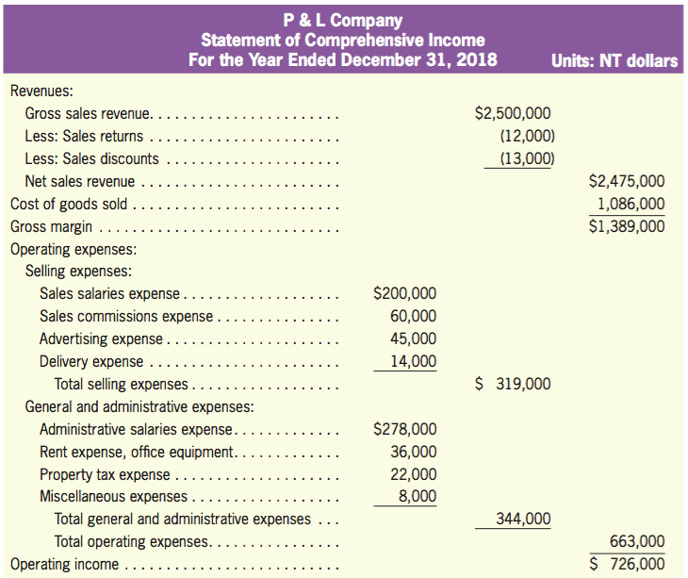
Other Revenues and Expenses
LO5
Exhibit 8.6

Slide 54
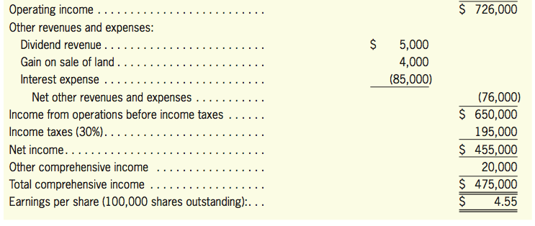
Other Revenues and Expenses
LO5
Exhibit 8.6

Slide 55
Earnings per Share
LO5
A company is required to show earnings per share (EPS) on the income statement of comprehensive income.
EPS allows potential investors to compare the profitability of all firms, whether large or small.
Net income
The number of shares of stock outstanding
Earnings per share
=

Slide 56
Earnings per Share
LO5
Basic Earnings Per Share
Based on historical information.
Diluted Earnings Per Share
Considers the effect on net income and shares outstanding of stock transactions that might occur in the future.

Slide 57
Earnings per Share
LO5
Example
Burt Company reported net income for the year 2018 of $300,000.
As of January 1, Burt had 100,000 shares of stock outstanding; those shares of stock were outstanding throughout the year.
In addition, as of January 1, Burt had stock options outstanding that allowed certain executives to receive 50,000 shares of stock for free at a time of their choosing. As of December 31, the executives had not yet exercised the options.

Slide 58
Earnings per Share
LO5
Example
Basic EPS: $3.00 per share
($300,000 net income/ 100,000 shares outstanding)
Diluted EPS: $2.00 per share
[$300,000/(100,000 shares + 50,000 potential shares)]

Slide 59
Labor Insurance*
Computational Details of Labor Insurance and Health Insurance Premiums
LO6
General Accident Benefits
Fixed rate: 8.5% of the salary.
The premium is payable by the employer, the employee, and the government according to 7:2:1 ratio.
Occupational Injury Payment
The rate varies with industry.
The insurance premium is in general solely payable by the employer.
E.g., the rate is 0.1% for computer manufacturers.

Slide 60
Labor Insurance*
LO6
Employment Insurance
Fixed rate: 1% of the salary.
The premium is payable by the employer, the employee, and the government according to 7:2:1 ratio.

Slide 61
Labor Insurance*
LO6
Illustration
Assume that Chi-yuen Chen, an employee of a computer manufacturing company, earns NT$44,000 for the month ended on January 31.
Payment by the employee
NT$44,000 ⨉ (8.5% + 1%) ⨉ 20% = NT$836
Payment by the employer
NT$44,000 ⨉ (8.5% + 1%) ⨉ 70% = NT$2,926
NT$44,000 ⨉ 0.1% ⨉ 100% = NT$44
NT$2,926 + NT$44 = NT$2,970

Slide 62
Health Insurance*
LO6
Starting from January 1, 2013, the National Health Insurance premium rate is 4.91% of the employee’s insured salary.
The premium is split between the employer (60%), the employee (30%), and the government (10%).
As of 2014, the average number of dependents is defined as 0.7.

Slide 63
Health Insurance*
LO6
Employee
Income Basis ⨉ Premium Rate ⨉ Contribution Ratio ⨉ (1 + Number of Dependents)
= Income Basis ⨉ 4.91% ⨉ 30% ⨉ (1 + Number of Dependents)
Employer
Income Basis ⨉ Premium Rate ⨉ Contribution Ratio ⨉ (1 + Average Number of Dependents)
= Income Basis ⨉ 4.91% ⨉ 60% ⨉ (1 + 0.7)

Slide 64
Health Insurance*
LO6
Illustration
Assume that Chi-yuen Chen has no dependents.
Payment by the Employee
NT$44,000 ⨉ 4.91% ⨉ 30% ⨉ 1 = NT$648
Payment by the Employer
NT$44,000 ⨉ 4.91% ⨉ 60% ⨉ 1.7 = NT$2,204

